Slide 1









ECO WARRIORS
Protection of endangered species
Presented by DTIL Group Number 16

Slide 2

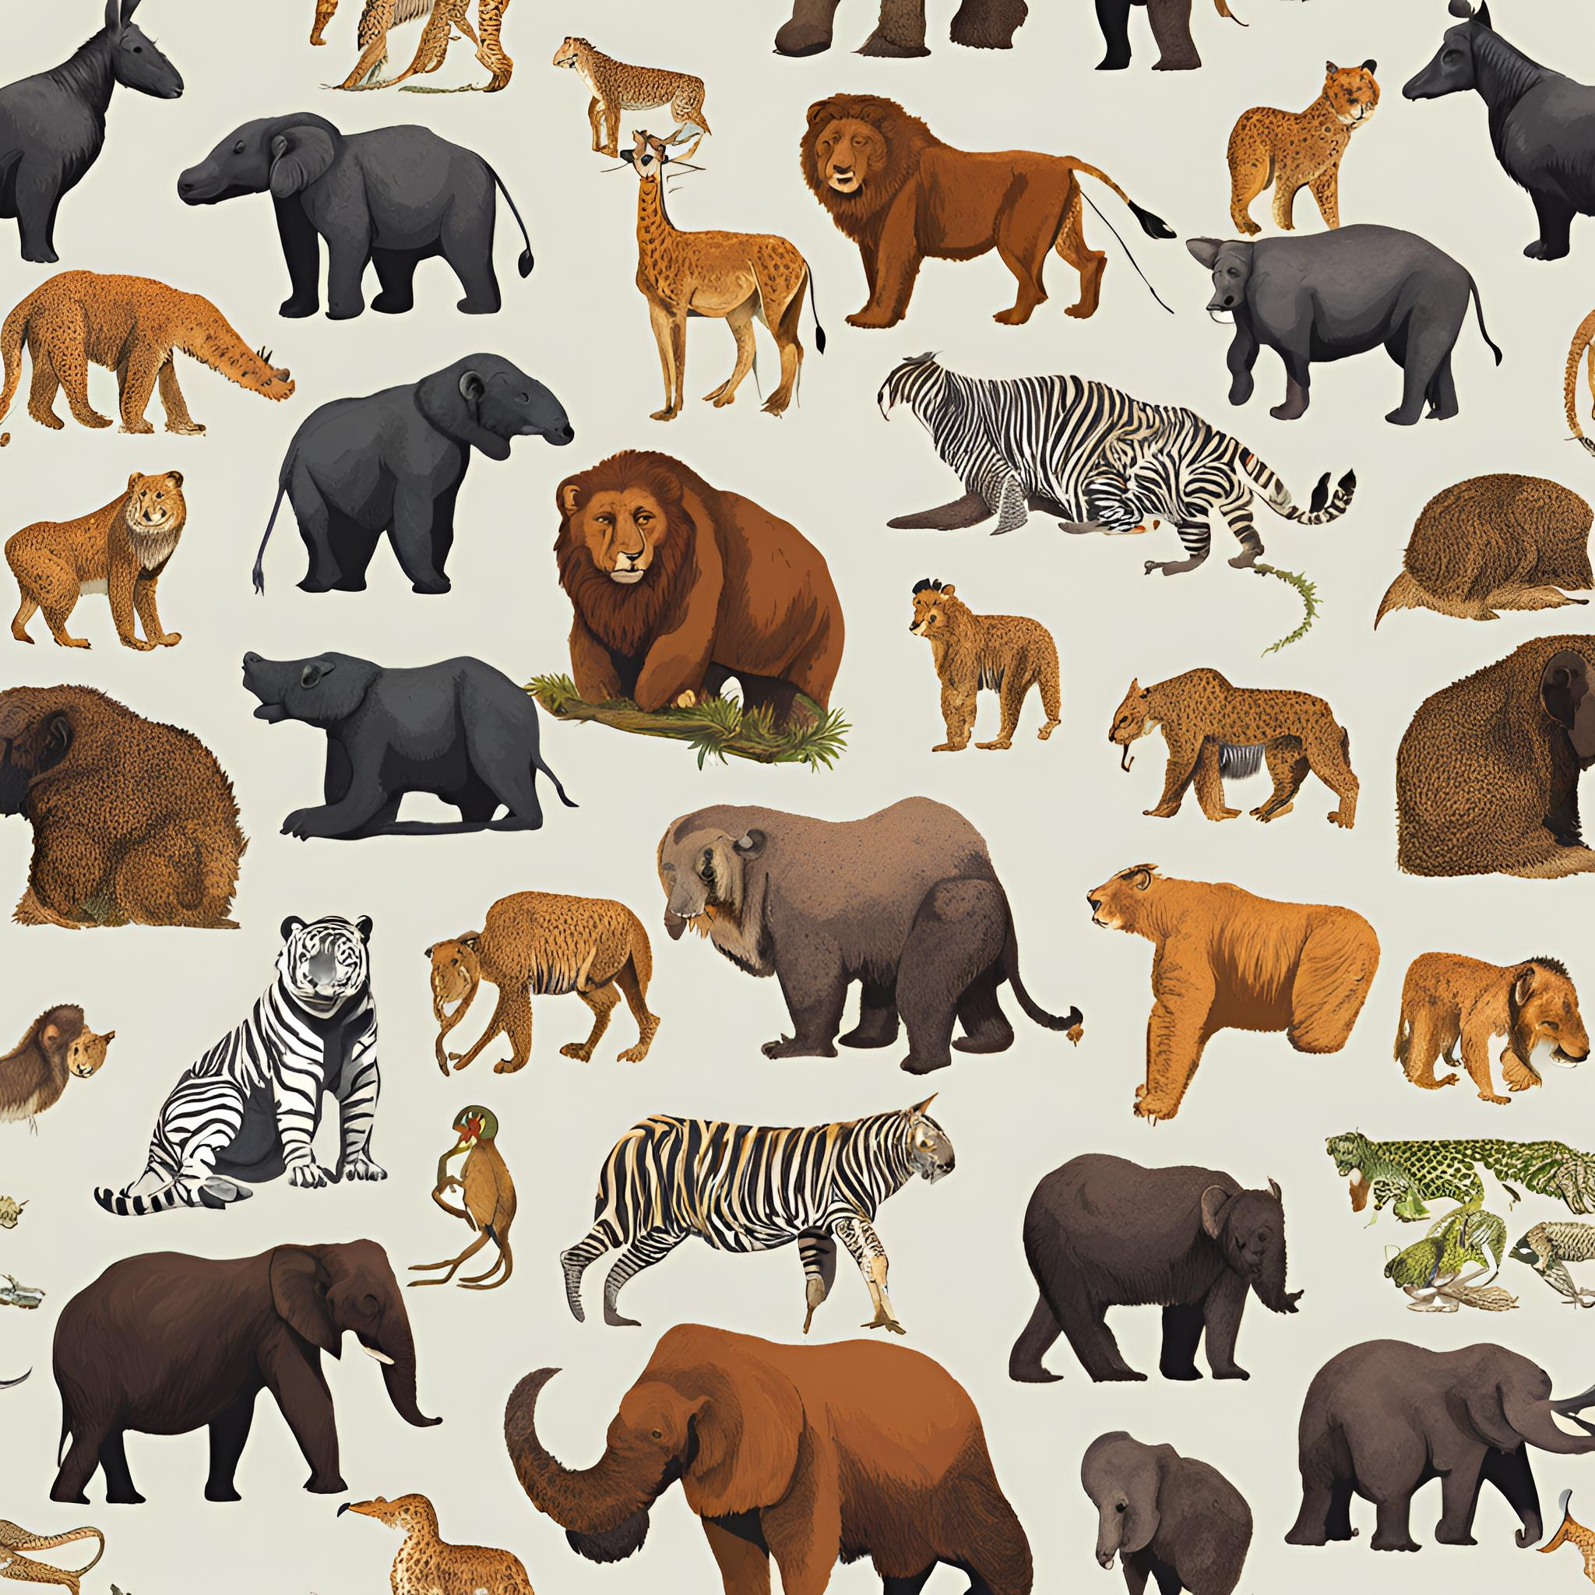

GROUP MEMBERS
Group leader : Ayush Deore
Group members : Vedant Admane
Sarthak Patil
Vedanti Vahadne
Smruti Gorde
Sanskruti Madhawai

Slide 3

About the Project
Aims to create awareness, conserve, protect and restore the populations of animals ,plant ,and other organisms at risk of extinction
The goal is to maintain biodiversity, ensuring healthy ecosystem and preserving natural balance of environment for the safety of planet and upcoming generation

Slide 4




PROBLEM STATEMENT
The ongoing loss of biodiversity is one of the most serious environmental challenges. A significant factor contributing to this crisis is the lack of public awareness about the importance of protecting endangered species.
RELEVANCE
Everyone suffers from continued loss of biological diversity since this impacts negatively on the natural environment and our own future. It is surprising that majority of individuals has no idea over the significance of endangered species to the environment. Awakening people can prevent the extinction of such species; people of all ages must prevent making the planet worse, but rather make it better for all species.

Slide 5






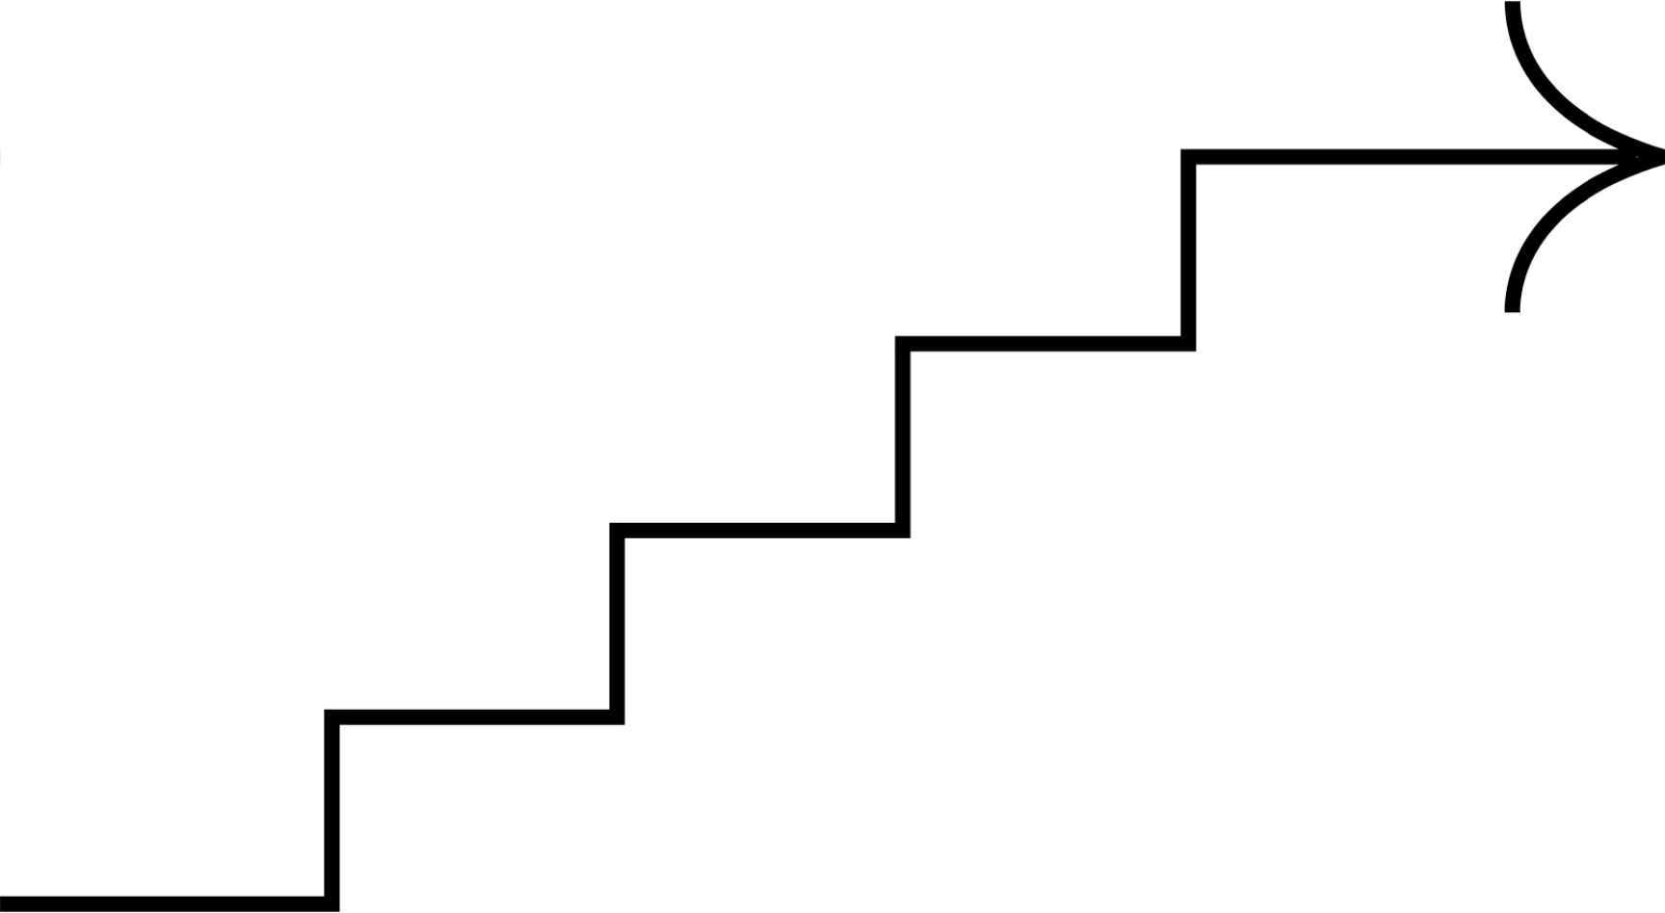

Mind mapping
September 11, 2024
Mind mapping
key words
categorization

Slide 6
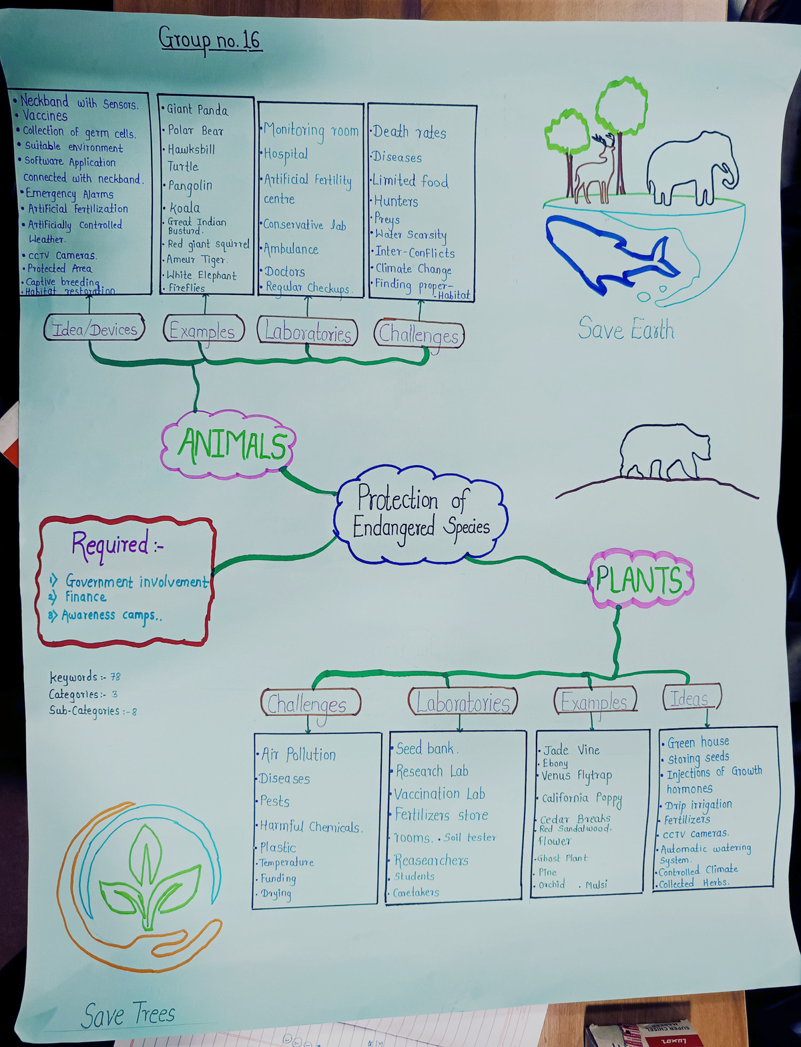
mind mapping

Slide 7


Persona construction
What is persona construction?
persona construction is the process of creating a detailed summary of a person ,that represent the different type of users , audiences product or a service you're trying to provide.
In this activity we have to find our end user which will be helpful for our project in future . After finding the end users we have to create persona on their basis of their life and how will they be helpful in our project as a end user.

Slide 8
Persona
(research student)
background
motivation
A student who wants to be a scientist to save endangered species.
Who lived in a big town.
Learned to love nature by going camping with
family and learning about it in school.
Wants to protect wildlife.
Motivated by wildlife documentaries.
passion through spending time in nature
Encouraged by Family and friend's friends support. Inspired by renewed conservationists.
doubts/fears
Worried about knowing enough skills for job.
Limited job opportunities in conservation Field.
Not sure if bel she can really help Species.
Scared of having trouble in finding information
Worried about endangered species faced by the
challenges faced
Didn't have much experience of knowledge about how to do research.
Balancing, coursework and research projects.
didn't have enough money to go on research trips or meetings.
Couldn't find a good teacher to help them.
Struggles with applying theoretical
aspiration
contribute to significant conservation projects know more about species in danger and how to protect them
Build a strong professional network.
Expand knowledge about endangered species Work as a conservation.
construct a story while explaining the persona to your peers and document the insights
Ria is a student who wants to save animals and plants. She grew up in a big city but loves nature. She's learning to be a scientist who protects endangered species. She wants to work with animals and plants in the real world but is worried about finding a job and having enough knowledge. She hopes to help save lots of animals and plants.

Slide 9
Persona
(local community)
Background
Motivation
Resides in rural area near a protected area or wildlife sanctuary.
Dependent on natural resources for livelihood like agriculture, fishing, etc.
Strong cultural connection to the land and wildlife.
Limited formal education but possesses traditional ecological knowledge.
Desire to protect the environment for future generations.
Maintain cultural and spiritual connection to the land.
Improve livelihood through sustainable practices.
Access to better education and healthcare for the community.
Doubts/fears
Uncertainty about the benefits of conservation efforts.
Concern about job loss due to conservation initiatives.
Fear of displacement from ancestral lands.
Lack of trust in government and conservation organizations.
Challenges faced
Loss of livelihood due to declining wildlife populations or habitat degradation.
Damage to crops and property caused by wildlife.
Lack of access to basic amenities and healthcare.
Limited opportunities for income generation.
Lack of awareness about conservation and sustainable practices.
Aspiration
Improved living conditions for the community.
Sustainable livelihood opportunities.
Access to quality education and healthcare.
Recognition and appreciation of traditional knowledge.
Construct a story while explaining the persona to your peers and document the insights
Maya is from a local communities living near protected areas often depend on natural resources for their livelihoods. They face challenges such as habitat loss, human-wildlife conflicts, and limited access to resources. While motivated to protect the environment, they worry about job losses and displacement. Their aspirations include improved living conditions, sustainable livelihoods, and peaceful coexistence with wildlife. Understanding these perspectives is essential for effective conservation initiatives that involve local communities as partners.

Slide 10
Persona
(eco tourist)
Background
Motivation
Urban Resident with a growing appreciation for nature.
Enjoy travelling and exploring new cultures.
Concerned about environmental
Seeks environmental and want's to feel a Connection to the nature.
Move out of daily routine and connected with nature.
Learn about different-different cultures and it’s eco-system across the world.
Contribution to conservation efforts through tourism.
Doubt/fears
Fear of getting robbed while travelling across the world.
Safety in remote area on visiting.
Worried about the ethical significance of wildlife tourism. Hesitation about spending money on eco-tourism
Challenges faced
Balancing the work life with the travelling.
Concerns about the safety and comfort in unfamiliar places.
Finding the perfect location for next travelling adventure.
Uncertainty about the places of visit.
Lack of funding for travelling.
Aspiration
Experience of the vast and diverse ecosystem and wild-life.
Capture real images of endangered species.
Learning new things through travelling.
Construct a story while explaining the persona to your peers and document the insights
Aryan, an eco-tourist, who is quiet close to nature and feels a connection with it. Aryan is concerned about environment and endangered animals, and want's to contribute for conservation of nature. He travels and tries to help the environment while learning about it, and sharing his knowledge with others. Understanding the importance of the nature, Aryan trios his best to protect environment as much as be can.

Slide 11


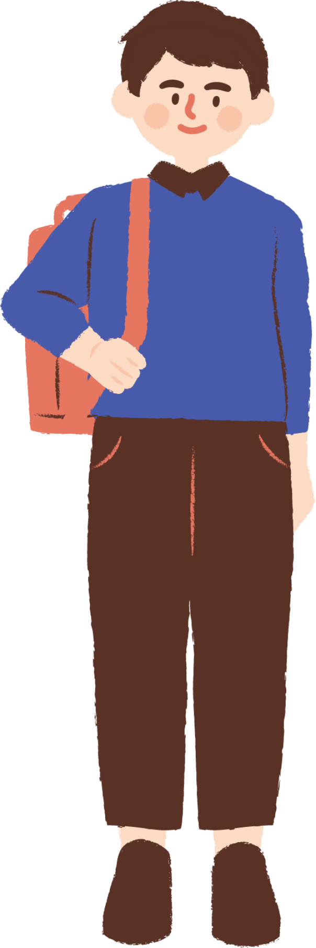
Wh- Questions
Applying the 5W1H Method to Endangered Species Protection.
The 5W1H method (Who, What, When, Where, Why, and How) is a powerful tool for planning and problem-solving. I've applied it to the complex issue of endangered species protection to ensure a comprehensive and effective approach.
.

Slide 12

What?
Idea / devices :
What is the reason of disruption in eco- system?
Climate Change
What is the overall purpose of forecasting endangered species?
Conservation.
Laboratory:
What is the reason of animal and plant death?
Diseases
What do laboratory help with?
Research.
Examples & Requirements
What role do government play in protecting species? Rules and regulations.
What limits public awareness of species?
Ignorance.
What delays conservation reforms in government? Politics.
Challenges faced
What are some of the main cause that led a species to extinction?
Overexploitation.
What is the reason in decline of plant species?
Invasive species.

Slide 13
Where?
Idea / devices
Where are the primary threats of this endangered species?
Hunters.
Where is genetic diversity in protection of endangered species?
Breeding.
Where species faces high risk due to the deforestation?
rainforest.
Laboratory
Where research faces problems in studying endangered species?
Remote areas.
Where do toxic waste go from factory?
Rivers and ocean.
Examples & Requirements
Where is the restoration of forest mostly relying on? NGO’s
Where has the geological range of plants declined over time?
Culture exponential.
Where do migration occur mostly?
Asia and Europe
Challenges faced
Where do habitat loss occur rapidly?
Growing area.
Where do international conservation lacks?
Border reinforcement.

Slide 14
When?
Idea / devices
1.when do the human activity harm the endangered species?
Ans During migration
2.when are technology-based protection solutions are ineffective?
Ans . Night time
Laboratories
1.when do invasive species causes significant ecological harm to other species ?
Ans .invasion
2.when are endangered species harmed for human needs?
Ans. trafficking
3.when are protection reform delayed ?
Ans. lack of funding
Examples & Requirements
1.when did overfishing threatening the marine species?
Ans. Exploitation
2.when do restore habitat conflict with human?
Ans. development
Challenges faced
1.when do pollution sources harm endangered species habitat?
Ans . Industrialization
2.when are native species difficult to reintroduce to new place?
Ans. Adaption

Slide 15
Why?
laborotary
1.why is climate changing?
Ans. global warming
2.why new trees do not survive longer?
Ans . lack of water
3.why is habitat restoration is a critical requirement for survival?
Ans . degradation
Examples
1.Why are captive breeding programs often successful?
Ans. stress
2.why is it hard to save the natural habitat of endangered species?
Ans . development
3.why the laws often fails to work?
Ans. weaker laws
idea/devices
1.why do ruks for protection fails?
Ans. enforcement
2.why are new protection tools not utilized?
Ans. adaptation
3.why do conservation organization struggle to collaborate?
Ans. ego
Challenges faced
1.why do diseases spread more rapidly among endangered species?
Ans. transmission
2.why do endangered species face health risk in polluted areas?
Ans. Toxicity

Slide 16
Who?
idea/devices
1.Who is responsible for protection of animals?
Government.
2.who benefits from the eco-tourism?
Local communities.
3.who causes pollution?
Humans.
Challenges faced
who is responsible for animals' death?
Predators.
2.who benefits from the illegal wildlife trade ?
Criminals.
laboratory
1.who is primary problem in illegal wildlife trade?
Smugglers.
2.who will benefit from protecting endangered species in upcoming time?
Future generations.
Examples
1.who faces challenges in protecting migratory species boundaries ?
Boundaries created by human.
2.what causes problem in species?
Internal conflicts.

Slide 17
How?
Idea / devices
1.How can we take help of common people for protection of endangered species ?
Supporting tourism.
2.how can education help in conservation projects?
Raising awareness.
Labs
1. how can we reduce deforestation?
Tree plantation
2.how are climate change and endangered species connected with each other ?
Habitat destruction.
Examples & Requirements
how can we reduce human impact on environment done by human ?
By sustainable practices.
2. how can disease spread be prevented ?
Disease and vaccinations.
Challenges faced
how can genetic diversity be preserved through science?
Genetic bottleneck.
2. how can economic models help support conservation ?
Economic pressure.

Slide 18








THEORY OF PRIORITIZATION
•This activity aims to help you prioritize different aspects from problems. You will assign points of 10g , 100g, and 1000g to each key feature, where higher the points the greater importance of priority.
Theory of priotarization gives a clear understanding on a
particular topic. In this first we identify all the problems related to
our topic using 5W1H matrix and give them points according to
the depth of the problem.
• We got 14 problems and prioritize them accordingly

Slide 19
PRIORITY WEIGHTAGE
SR NO. | problems | points
1 | GLOBAL WARMING | 5100
2 | LACK OF AWARNESS | 6000
3 | HUNTING | 4200
4 | HABITAT LOSS | 4110
5 | DISEASES | 330
6 | OVEREXPLIOTATION | 2400
7 | DEFORESTATION | 6000

Slide 20
PRIORITY WEIGHTAGE
SR NO. | problems | points
8 | SPECIES MIGRATION | 600
9 | INVASION | 3300
10 | ILLEAGEL TRADE | 1500
11 | TRANSMISSION | 2400
12 | INDUSTRIALIZATION | 600
13 | TRANSMISSION | 4110
14 | DEGRADATION OF LAND | 6000

Slide 21








SCAMPER
SCAMPER is a device and a creative thinking technique developed by Bob Eberle in the early 1970s. It's primarily used for idea generation, problem-solving, and innovation.
SCAMPER is an acronym that stands for:
S - Substitute
C - Combine
A - Adapt
M - Modify
P - Put to Another Use
E - Eliminate
R - Rearrange

Slide 22
TOOLS USED
In the SCAMPER technique, Modify refers to changing certain characteristics of an existing product, system, or process to improve it or make it more suitable for a particular purpose.
Reforesting: Modify habitats (National parks etc.) through reforestation or planting native species to restore ecosystems, providing necessary resources like food, shelter, and breeding areas for endangered species.
"Adapt" in the SCAMPER tool helps you to adjust existing ideas, products, or solutions to better suit a new purpose or context.
Adapt" is used to transform existing educational content from various websitee about endangered species into interactive, mobile-friendly formats, such as simplified articles and infographics making it engaging and easy for the public to understand and act on.

Slide 23
Tools we skipped
1. Substitute
Drawback: The substitute might not work as effectively.
Example: Replacing natural wetlands with artificial ponds to protect an endangered frog species might not provide the same nutrients or breeding grounds, leading to poor survival rates.
2. Combine
Drawback: Combining too many elements can create complexity.
Example: Combining wildlife corridors with human recreational spaces might lead to more human-animal conflicts rather than improving habitat connectivity for endangered species.
3. Put to Another Use
Drawback: The resource may not function effectively for its new use.
Example: Repurposing abandoned farmland for wildlife habitat may not provide sufficient cover, water, or food for endangered species like tigers, making it unsuitable as a sanctuary.
4. Eliminate
Drawback: Eliminating components can disrupt the system.
Example: Eliminating predators to protect an endangered prey species could cause overpopulation of the prey, leading to ecosystem imbalance and food shortages for other species.
5. Rearrange/Reverse
Drawback: Rearranging processes can cause confusion or harm.
Example: Reversing the order of reintroducing animals into the wild (releasing them before restoring habitat) could lead to their quick disappearance due to the lack of a suitable environment.

Slide 24
Journey map
Journey Map of Local Communities
1. Worried about the ecosystem.
2. Looks for something informative in the app.
3. Reads the latest information about endangered species.
4. Understands the importance of protecting endangered species.
5. Feels sad after reading the latest count of species.
6. Finds information about various plant species.
7. Reads information about national parks and their locations using the map.
8. Reads conservation tips.
9. Uses the app as a tourist guide.
10. Makes a donation

Slide 25
Journey map
Journey Map of Eco Tourists
1. Interested in sustainable travel options.
2. Feels confused due to the lack of a proper travel guide.
3. Searches for eco-friendly destinations and activities in the app suggested by the tourist guide.
4. Reads about the importance of protecting local wildlife and habitats.
5. Learns about endangered species in the travel area.
6. Discovers information about national parks.
7. Uses the app's map to find nearby national parks and conservation areas.
8. Reads tips on conservation practices.
9. Makes a donation to support conservation efforts.
10. Shares experiences and reviews to promote eco-tourism.

Slide 26
Journey map
Journey Map of a Research Student
1. Identifies a research topic related to endangered species or ecosystems.
2. Lacks the latest information about endangered species and their population counts.
3. Searches for detailed information and resources in the app.
4. Reads the latest data on endangered species.
5. Analyzes species population and conservation trends.
6. Finds detailed information about different plant and animal species.
7. Uses the app's map feature to locate key habitats and National parks.
8. Takes notes on conservation efforts.
9. Reads conservation methodologies and tips.
10. Shares findings and contributes to awareness campaigns.
11. Makes a donation to support conservation research.

Slide 27
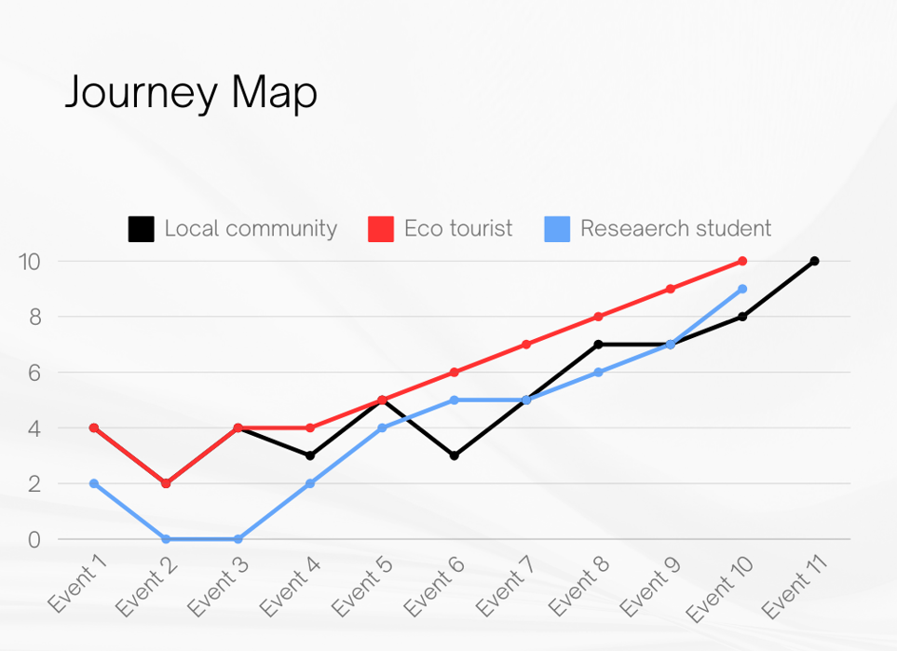
Graph

Slide 28

THANK YOU

